Slide 1
Machine Learning and having it deep and structured
Hung-yi Lee
Notes:
本课程讲解三个内容
1、什么是 Machine Learning
2、什么是 deep Learning
3、什么是 structured Learning

Slide 2
What is Machine Learning?

Slide 3

You know how to program …
You can ask computers to do lots of things for you.
However, computer can only do what you ask it to do.
Computer can never solve the problem you can’t solve.

Slide 4
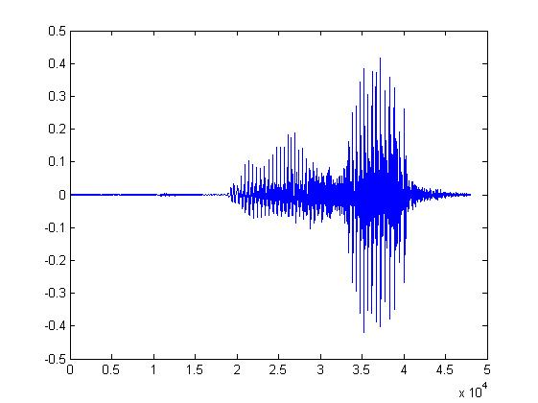
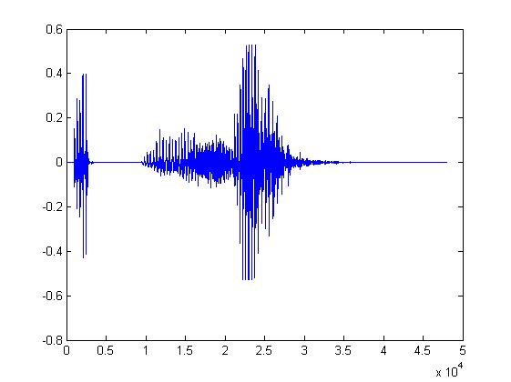
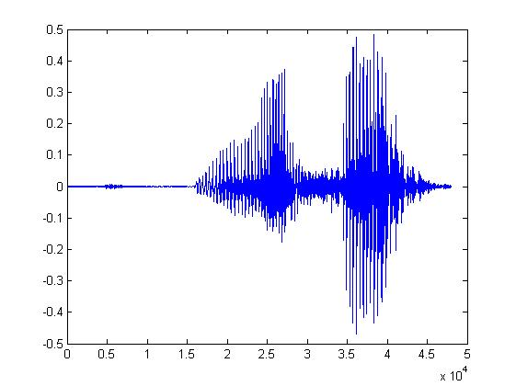
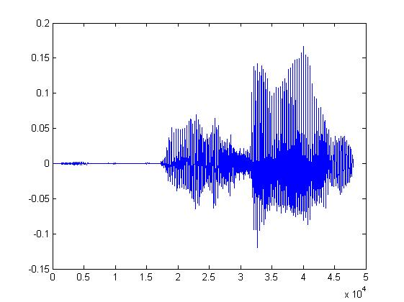
Some tasks are very complex
One day, you are asked to write a program for speech recognition.
Find the common patterns from the left waveforms.
你好
你好
You quickly get lost in the exceptions and special cases.
It seems impossible to write a program for speech recognition.
你好
你好
Notes:
Find the common patterns from the left waveforms. 从左侧波形中找出常见模式。
You quickly get lost in the exceptions and special cases. 您很快就会迷失在例外和特殊情况中。
It seems impossible to write a program for speech recognition. 编写语音识别程序似乎是不可能的。

Slide 5


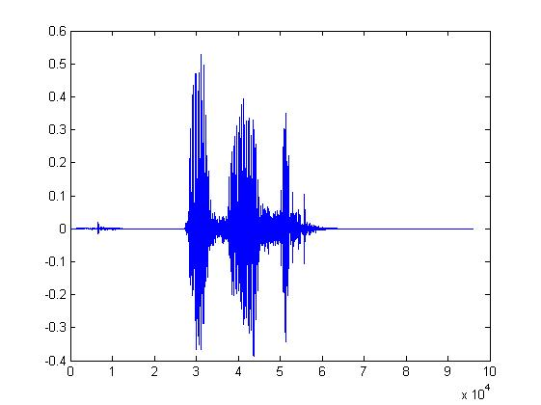
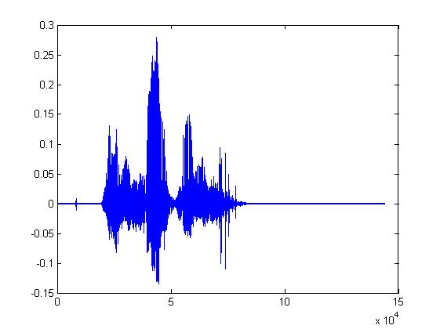
Let the machine learn by itself
Learning ......
你好
大家好
You said “你好”
人帥真好
You write the program for learning.
A large amount of audio data

Slide 6

Learning ≈ Looking for a Function
Speech Recognition
Handwritten Recognition
Weather forecast
Play video games
“你好”
“2”
weather today
“sunny tomorrow”
Positions and number of enemies
“fire”

Slide 7

Framework
“你好”
“2”
Model
Hypothesis Function Set
label
大家好
“Best” Function
Training:
Pick the best Function f*
Testing:
Training
Data
function input
function output

Slide 8
This Course
Machine Learning
Deep Learning
Structured Learning

Slide 9
Deep Learning

Slide 10
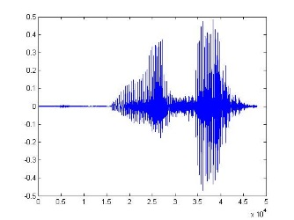
What is Deep Learning?
Model
Production line (生產線)
Hypothesis Functions
Simple
Function 1
Simple
Function 2
Simple
Function N
……
“Hello”
A very complex function
End-to-end training:
What each function should do is learned automatically
Notes:
It is hard to define deep learning.
生產線的概念

Slide 11
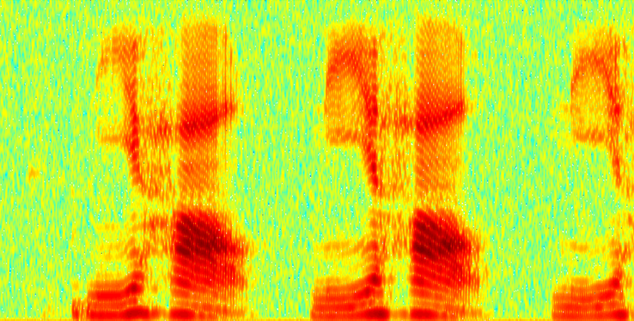
Deep v.s. Shallow - Speech Recognition
Shallow Approach
DFT
Waveform
spectrogram
GMM
DCT
log
…
“Hello”
Filter bank
MFCC
Each box is a simple function in the production line:
:hand-crafted
:learned from data
Notes:
Shallow - Speech Recognition 浅层 — 语音识别
Shallow Approach 浅显的做法

Slide 12
Deep v.s. Shallow - Speech Recognition
“Bye bye, MFCC”
- Deng Li in Interspeech 2014
Deep Learning
f₁
f₂
All functions are learned from data
f₃
f₅
f₄
“Hello”
Less engineering labor, but machine learns more

Slide 13
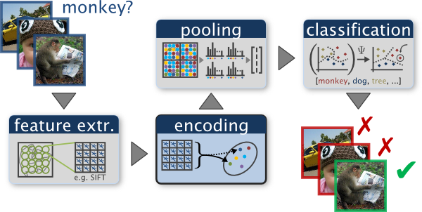
Deep v.s. Shallow - Image Recognition
Shallow Approach
http://www.robots.ox.ac.uk/~vgg/research/encoding_eval/
:hand-crafted
:learned from data

Slide 14

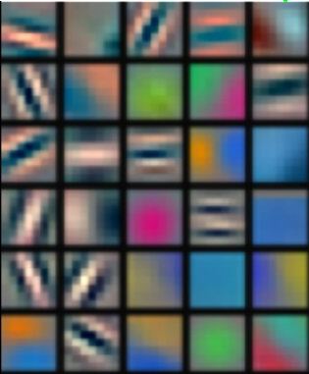
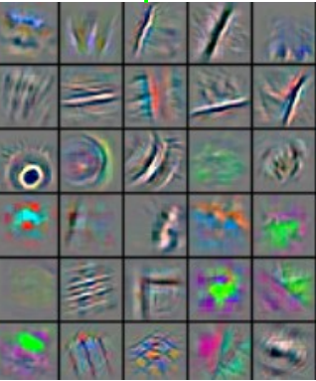
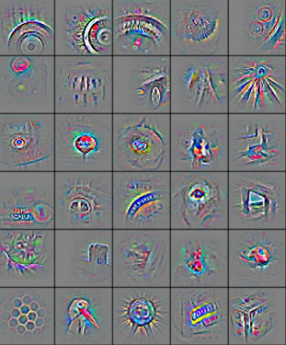
Deep v.s. Shallow - Image Recognition
Reference: Zeiler, M. D., & Fergus, R. (2014). Visualizing and understanding convolutional networks. In Computer Vision–ECCV 2014 (pp. 818-833)
Deep Learning
All functions are learned from data
f₁
f₂
f₃
f₄
“monkey”

Slide 15
What is Deep Learning?
Model
Production line
Deep learning usually referred to neural network based approach
Hypothesis Function Set
Simple
Function 1
Simple
Function 2
Simple
Function N
……
“Hello”
A very complex function
End-to-end training:
What each function should do is learned automatically

Slide 16
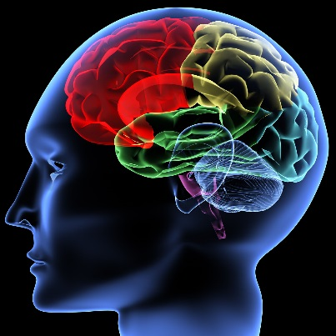
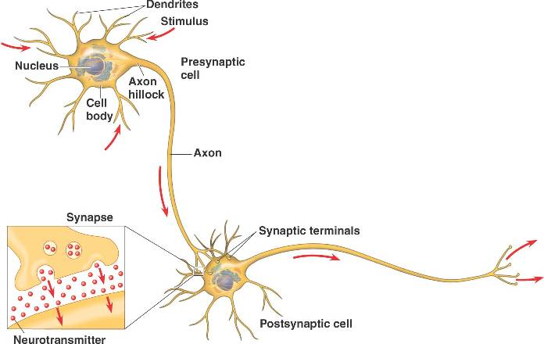
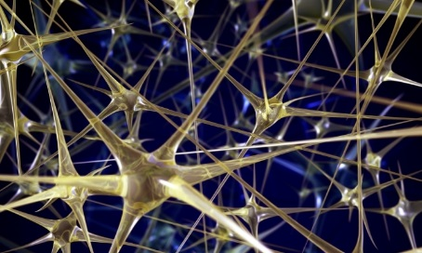
Inspired from Human Brains

Slide 17
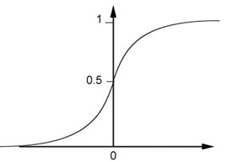
A Neuron for Machine
Each neuron is a very simple function
Activation function
…
Sigmoid function
bias

Slide 18
Deep Learning
A neural network is a complex function:
Cascading the neurons to form a neural network.
Each layer is a simple function in the production line.
Input
Layer 1
Layer 2
Layer L
Output
……
……
……
……
……
……
……
Hidden Layer
Notes:
Cascading the neurons to form a neural network. 将神经元级联起来形成神经网络。
Each layer is a simple function in the production line. 每一层都是生产线上的一个简单功能。

Slide 19
Ups and downs of Deep Learning
1960s: Perceptron (single layer neural network)
1969: Perceptron has limitation
1980s: Multi-layer perceptron
Do not have significant difference from DNN today
1986: Backpropagation
Usually more than 3 hidden layers is not helpful
1989: 1 hidden layer is “good enough”, why deep?
2006: RBM initialization (breakthrough)
2009: GPU
2011: Start to be popular in speech recognition
2012: win ILSVRC competition (image)
Notes:
Perceptron 感知机

Slide 20
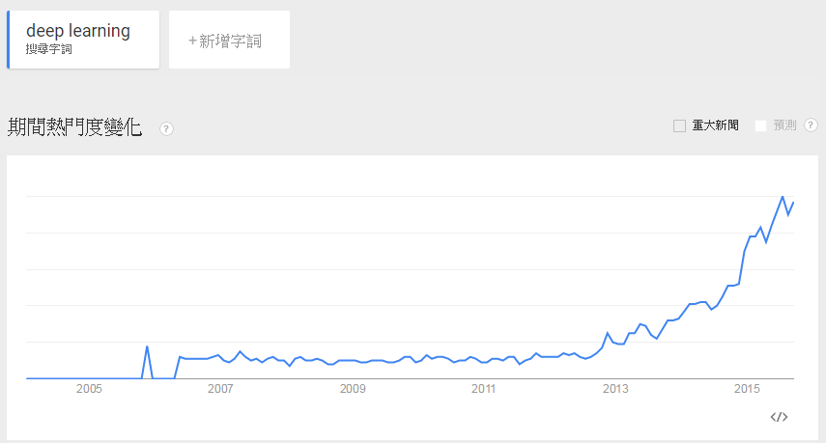
Become very Popular

Slide 21
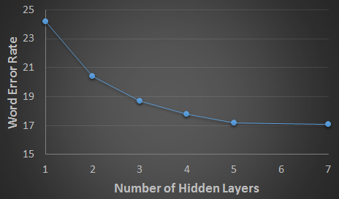
Why Deep Learning?
Deeper is Better.
Speech recognition
Seide, Frank, Gang Li, and Dong Yu. "Conversational Speech Transcription Using Context-Dependent Deep Neural Networks." Interspeech. 2011.
Notes:
横坐标是 隐藏层 的数量
纵坐标是 错误率
随着隐藏层数量的增加，错误率越来越小

Slide 22
Why Deeper is Better?
Deep works better simply because it uses more parameters.
……
……
……
……
……
Shallow
Deep

Slide 23
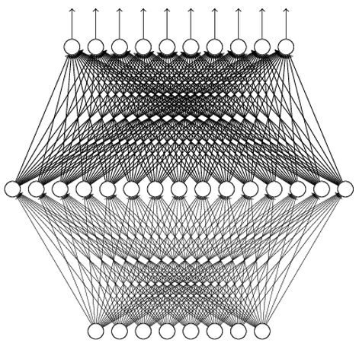
Universality Theorem
Any continuous function f
Can be realized by a network with one hidden layer
(given enough hidden neurons)
What is the reason to be deep?
Reference: http://neuralnetworksanddeeplearning.com/chap4.html
Why “Deep” neural network not “Fat” neural network?
Notes:
Universality Theorem 普遍性定理
Any continuous function f 任何连续函数 f
Can be realized by a network with one hidden layer 都可以通过具有一个隐藏层的网络实现

Slide 24
Fat + Short v.s. Thin + Tall
If they have the same parameters,
Which one is better?
……
……
……
Shallow
Deep
Notes:
Fat + Short v.s. Thin + Tall 胖+矮 vs. 瘦+高

Slide 25
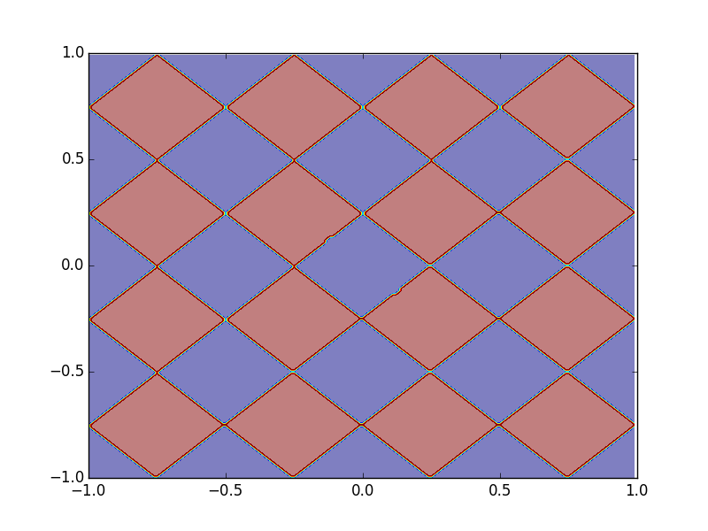
Fat + Short v.s. Thin + Tall Toy Example
Sample 10,0000 points as training data
1
0
……
……
0 or 1
……
……
……
……

Slide 26
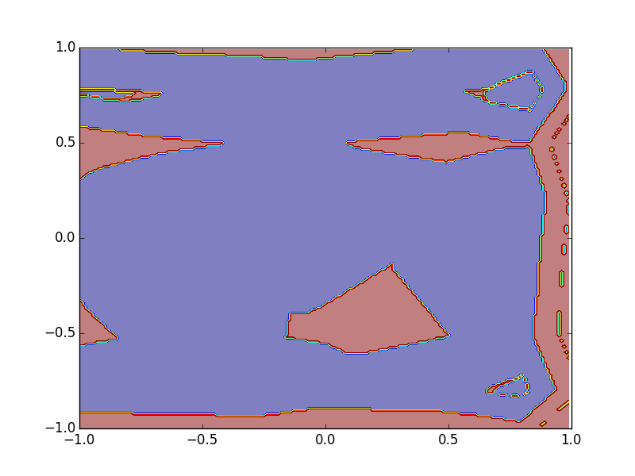
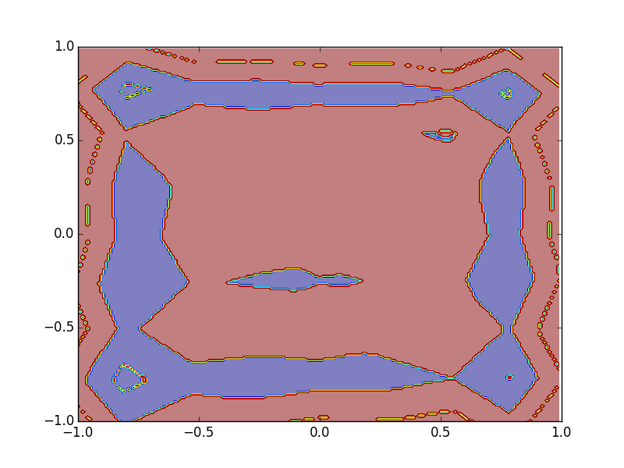
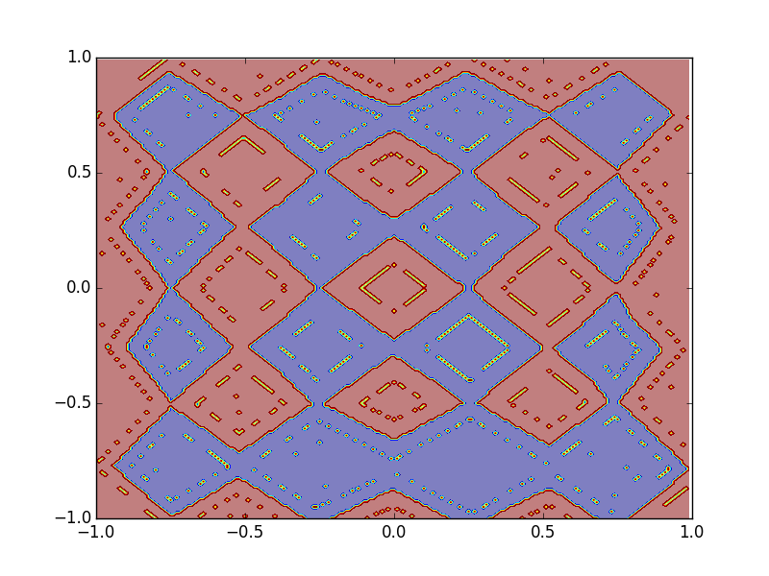
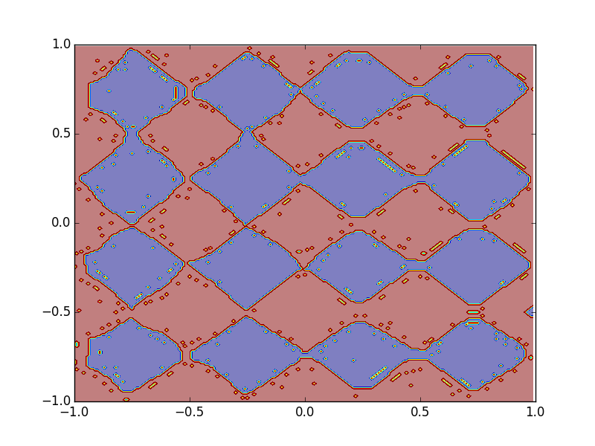
Fat + Short v.s. Thin + Tall Toy Example
1 hidden layer:
(A) 125 neurons
(B) 500 neurons
(C) 2500 neurons
3 hidden layers:
Q: the number of parameters close to (A), (B) or (C)?

Slide 27
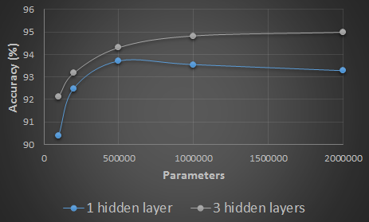
Fat + Short v.s. Thin + Tall Hand-writing digit classification
Same parameters
Deeper: Using less parameters to achieve the same performance

Slide 28
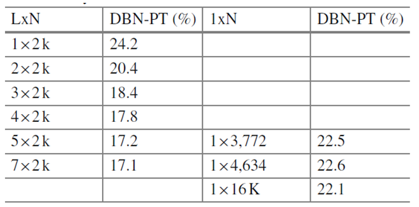
Fat + Short v.s. Thin + Tall Speech Recognition
Word error rate (WER)
Multiple layers
1 hidden layer
Seide, Frank, Gang Li, and Dong Yu. "Conversational Speech Transcription Using Context-Dependent Deep Neural Networks." Interspeech. 2011.

Slide 29
Think about Logic Circuits ……
A two-layer circuit of logic gates can represent any Boolean function.
Using multiple layers of logic gates to build some functions are much simpler (less gates needed).
E.g. parity check
Circuit
1 0 1 0
1 (even)
For input sequence with d bits,
Circuit
Two-layer circuit need O(2^{d}) gates.
0 0 0 1
0 (odd)
Notes:
Think about Logic Circuits 思考逻辑电路

Slide 30
Think about Logic Circuits ……
A two-layer circuit of logic gates can represent any Boolean function.
Using multiple layers of logic gates to build some functions are much simpler (less gates needed).
E.g. parity check
XOR
1
0
0
1
0
1
0
With multiple layers, we need only O(d) gates.

Slide 31
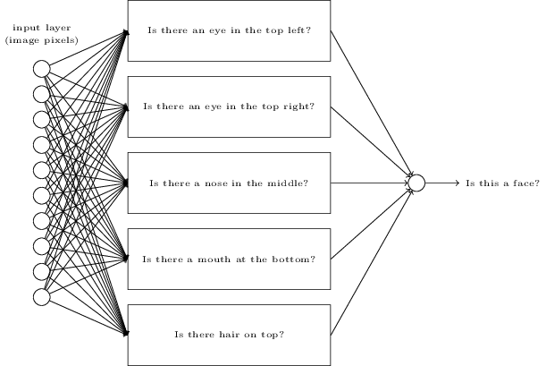
Back to Deep Learning
Some functions can be easily represented by deep structure
Perhaps the functions that can be naturally decomposed into several steps
E.g. image
http://neuralnetworksanddeeplearning.com/chap1.html
Notes:
Some functions can be easily represented by deep structure 有些函数可以很容易地用深层结构来表示
Perhaps the functions that can be naturally decomposed into several steps 也许可以自然地分解成几个步骤的函数

Slide 32
Back to Deep Learning
Some functions can be easily represented by deep structure
Perhaps the functions that can be naturally decomposed into several steps
E.g. image
To represent the functions with shallow structure needs much more parameters
More parameters imply more training data needed
To achieve the same performance, deep learning needs less training data
With the same amount of data, deep learning can achieve better performance.

Slide 33
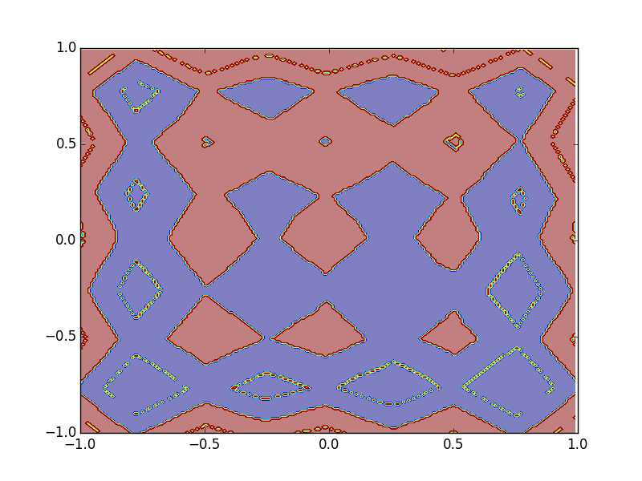
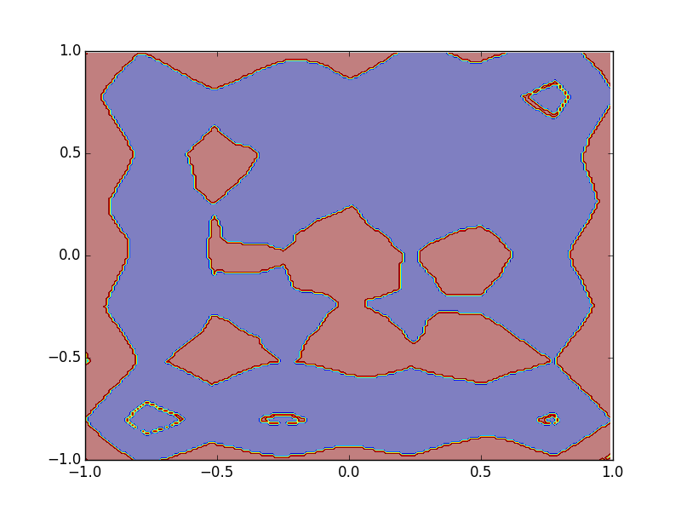
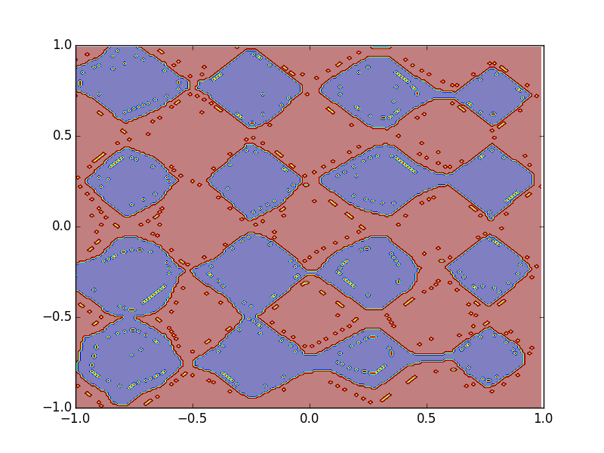
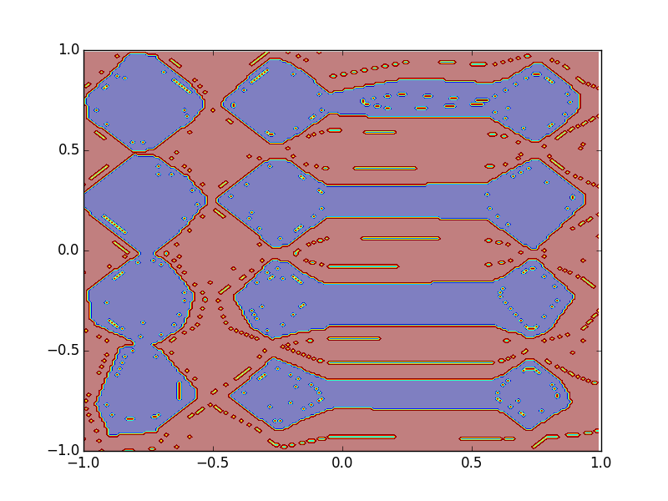
Size of Training Data
Different numbers of training examples
10,0000
5,0000
2,0000
1 hidden
layer
More parameters
3 hidden
layers
Less parameters

Slide 34
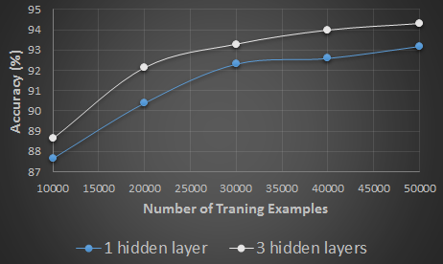
Size of Training Data
Hand-writing digit classification
Deeper: Using less training data to achieve the same performance
Notes:
100k

Slide 35
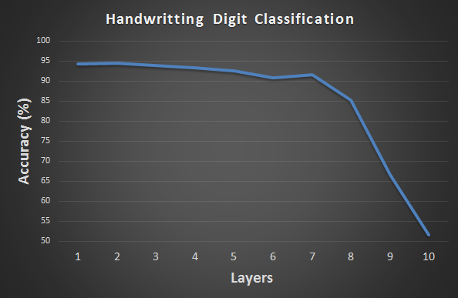
Why deep is not popular before?
In the past, usually deep does not work ……
?
We will go back to this issue in the following lectures.

Slide 36
What is Structured Learning?

Slide 37
In the real world ……
X (Input domain):
Sequence, graph structure, tree structure ……
Y (Output domain):
Sequence, graph structure, tree structure ……

Slide 38
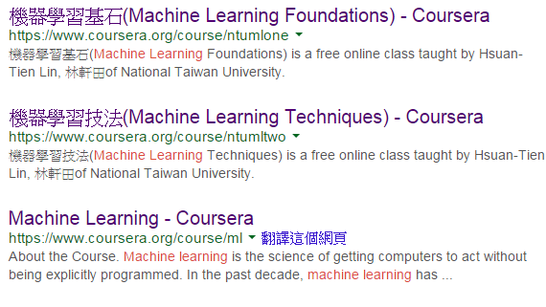
Retrieval
“Machine learning”
(keyword)
A list of web pages (Search Result)
Notes:
Structured Learning 的应用
Retrieval 检索

Slide 39
Translation
“Machine learning and having it deep and structured”
“機器學習及其深層與結構化”
(One kind of sequence)
(Another kind of sequence)

Slide 40
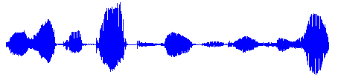
Speech Recognition
“大家好，歡迎大家來修機器學習及其深層與結構化”
(One kind of sequence)
(Another kind of sequence)

Slide 41
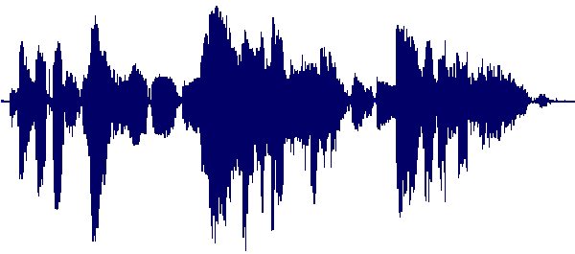
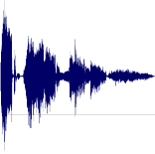
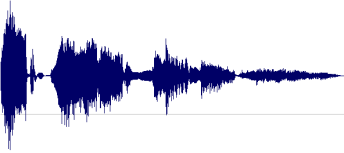
Speech Summarization
Record Lectures
Select the most informative segments to form a compact version
Summary

Slide 42

Object Detection
Image
Object Positions
Haruhi
Mikuru

Slide 43
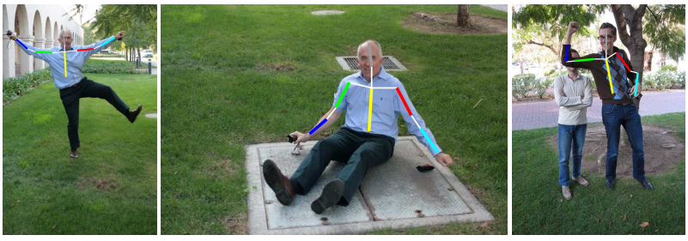
Pose Estimation
Image
Pose
Source of images: http://groups.inf.ed.ac.uk/calvin/Publications/eichner-techreport10.pdf
Notes:
Pose Estimation 姿态估计

Slide 44
Concluding Remarks
Machine Learning
Deep Learning
Structured Learning
Notes:
Deep learning is method
Structured learning is problem

Slide 45
Reference
No Textbook
Deep Learning
“Neural Networks and Deep Learning”
written by Michael Nielsen
http://neuralnetworksanddeeplearning.com/
“Deep Learning” (not finished yet)
Written by Yoshua Bengio, Ian J. Goodfellow and Aaron Courville
http://www.iro.umontreal.ca/~bengioy/dlbook/
Structured Learning
No suggested reference

Slide 46
Thank you!

Slide 47
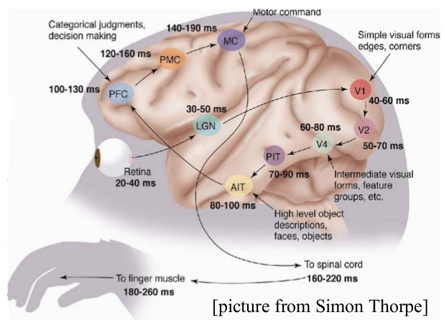
Human Brains are Deep

